Slide 1
Fundamental Skills and Strategies
Notes:
We’re going over fundamentals first just to ground the following activities- these skills should be employed throughout
This is going to be a very interactive workshop - structured with bits of slides followed by activities. When we’re up here putting things on slides we want you to be engaged- communicate with us. So I’m going to start with a question - If you were going to come up with the two most fundamental rules for effective science communiction- or just communication period- what would you come up with

Slide 2
Communicating Science Effectively
Know Your Goal(s)
Know Your Audience
Notes:
Building confidence (include general presentation skills and imrov)
Why are we learning these skills? Do be more confident when the unexpected happens. General strategies to be comfortable across contexts.
Now for some tips and tricks

Slide 3
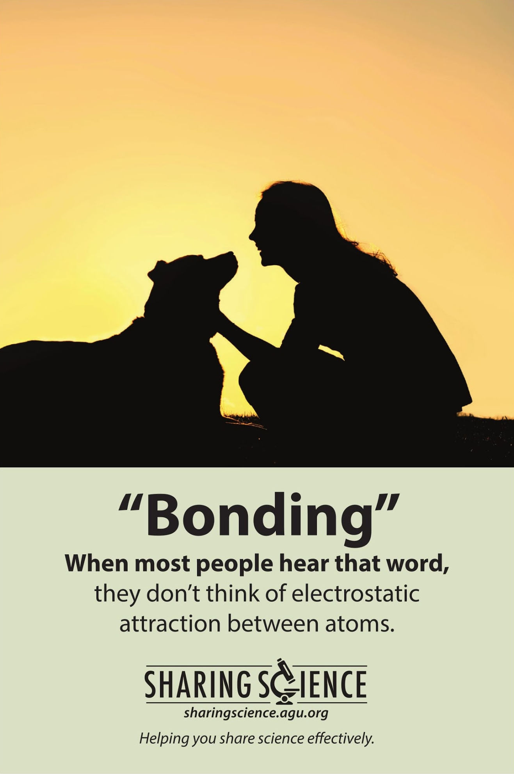
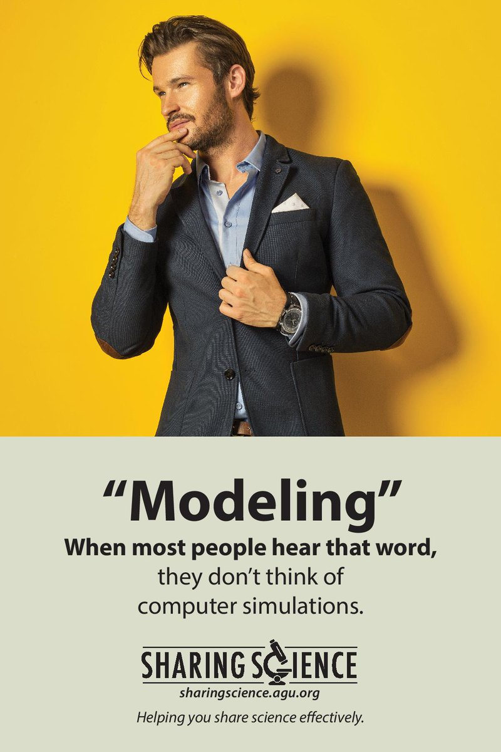
Communicating Science Effectively
Avoid Jargon
Notes:
Jargon is great. It lets us communicate quickly and precisely with other scientists- plus it makes you sound smart. But it can absolutely kill a communication with the public. I work on computational protein design which uses monte carlo simualtions to explore the conformational space of peptide chains to develop new therapeutics. Two strategies - avoid it or where necesariy define it -but build a ramp to the jargon. Don’t say a protein, a tiny biological machine in your body, say the biological machines that do the work of your body, which are caleld proteins

Slide 4
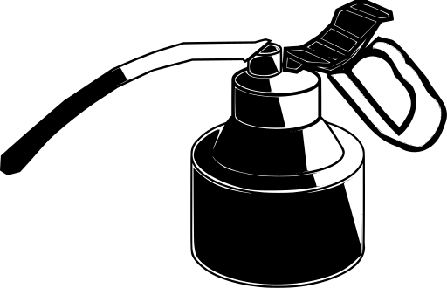
Communicating Science Effectively
Avoid Jargon
Practice Distillation
“catalyst” =
Notes:
You have years of research into the field, the people you’re talking to probably haven’t. They don’t have the time to get an entire PhD during your talk, so only give them the information they need for the story you’re telling - don’t dumb down, distil

Slide 5
Communicating Science Effectively
Avoid Jargon
Practice Distillation
Utilize Storytelling
Climax
Development
Tension
Complicating
Action
Resolution
Set-up/Hook
Act I
Act II
Act III
Time
Notes:
Building confidence (include general presentation skills and imrov)
Why are we learning these skills? Do be more confident when the unexpected happens. General strategies to be comfortable across contexts.

Slide 6
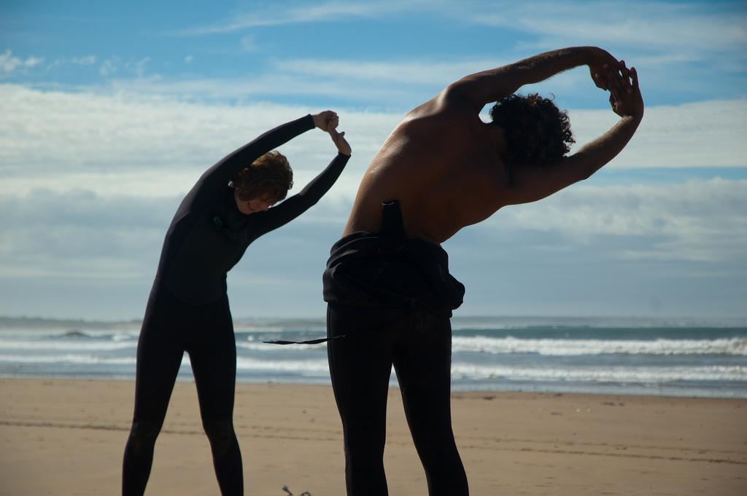
Communicating Science Effectively
Avoid Jargon
Practice Distillation
Utilize Storytelling
Be Prepared
Notes:
This means mental and physical preperation. Know your audience know your message, practice, practice, practice. Memorize then forget. Stretch. This is an interactive wokrshop stand up stretch out squish your face

Slide 7
Responding to the Unexpected
Pause
Remember your goal(s)
Listen
Learn about your audience
Adapt and respond using improvisation
Yes, and…
Notes:
Improv is all about responding to the absurd while affirming it- yes and. That’s how you respond to surprising situations. Practice makes perfect.

Slide 8
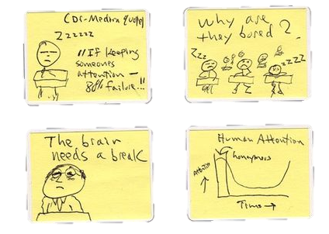
Today’s goal: Prepare for a 15 min talk
Jargon
Distillation
Storytelling
Storyboard
Notes:
Jargon (Conor) - Will define types of jargon, discuss why we use it, and when it may or may not be appropriate.
Distillation (Hally) - Since our goal is to provide you a strategy for designing a 15-minute talk, we need to talk about distillation. How to compress your research without compromising or “dumbing down” your methods and conclusions.
Storytelling (Mengying) - The latter half of of this workshop will focus on accomplishing this goal while engaging your audience through storytelling.
At the end of the workshop you’ll get to outline the story of your own research through storyboarding.

Slide 9
Describe your research in a few sentences. (eg. hypothesis, main conclusion, driving question)
Notes:
3-5 min.
If your just starting your research feel free to describe your research hypothesis/goals. If you’re further along in your program you can briefly describe your results and conclusions.

Slide 10
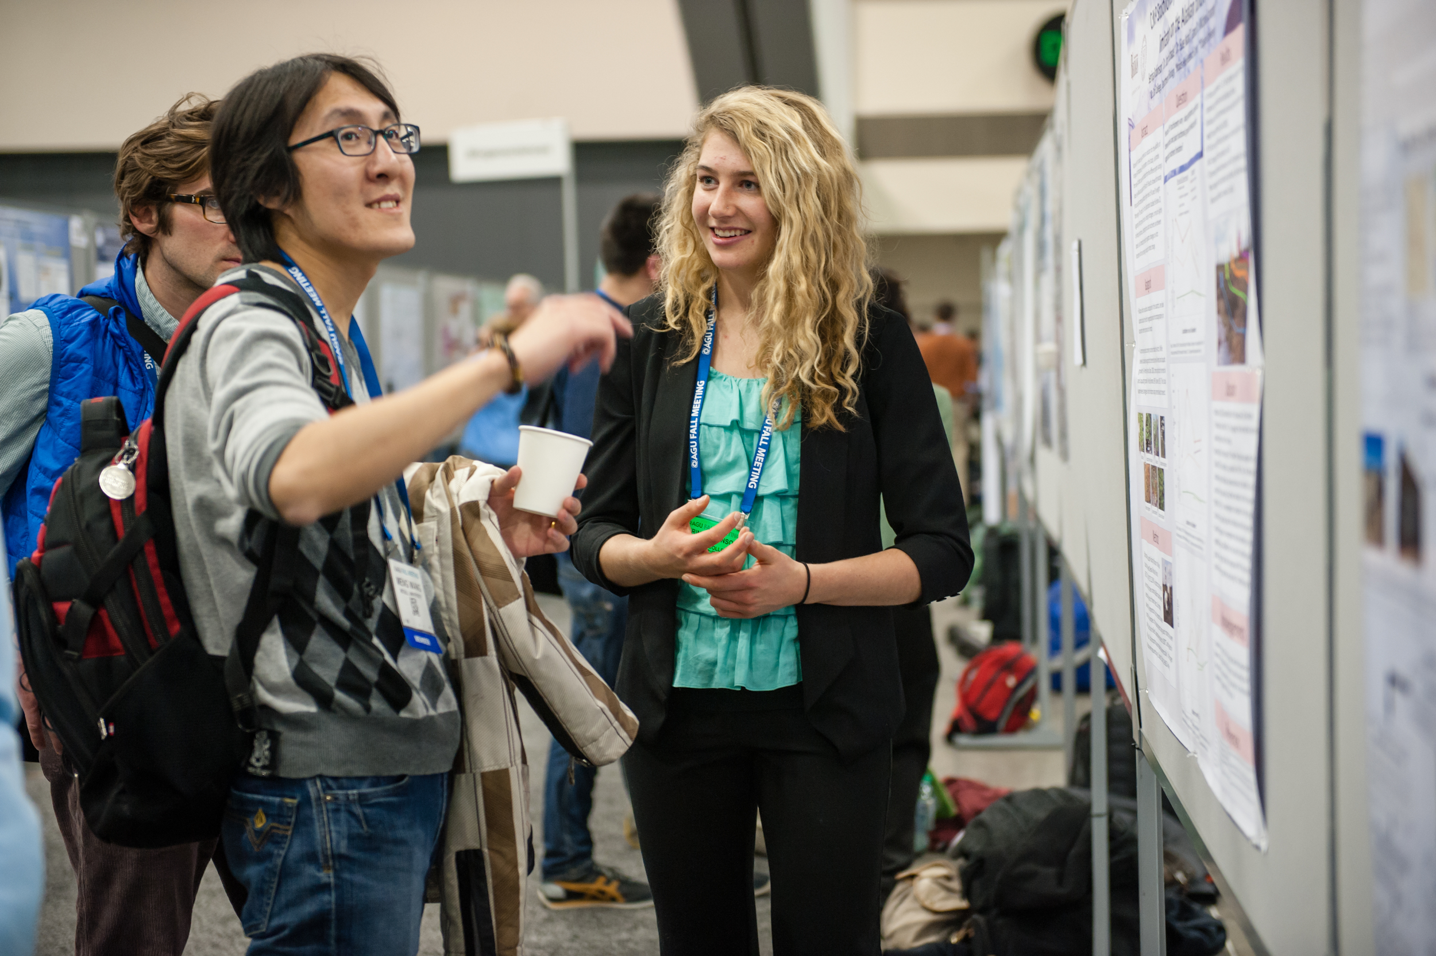
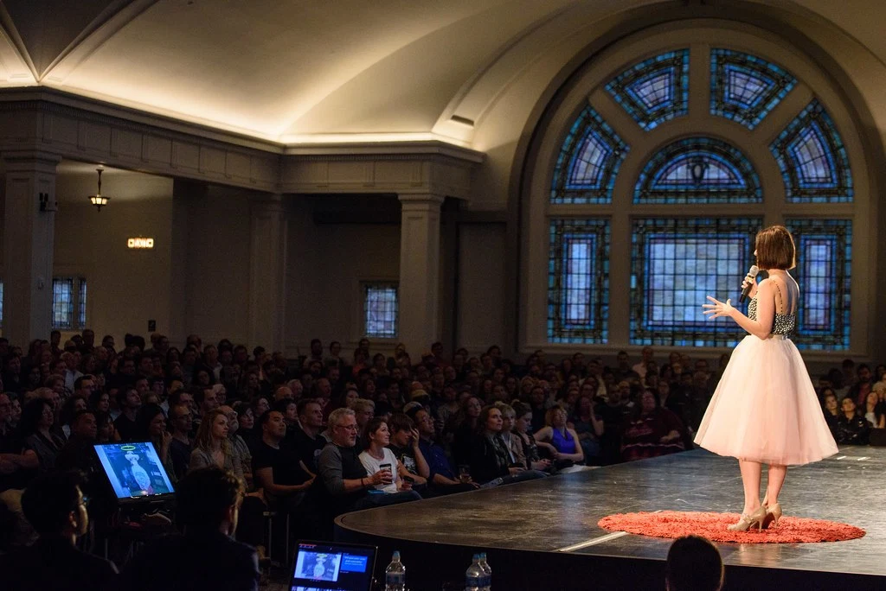
Why is this useful?
Communicate your research to other scientists.
Communicate your research to the general public.
Notes:
Science communication is a skill that you will use time and time again, throughout your career and your life.
No matter where you go after you finish your degree, you will have to communicate your science to other scientists (co-workers) and non-scientists (employees, bosses, etc.)
If you can’t communicate your research effectively, even amongst your peers, its benefits may go unrealized.

Slide 11
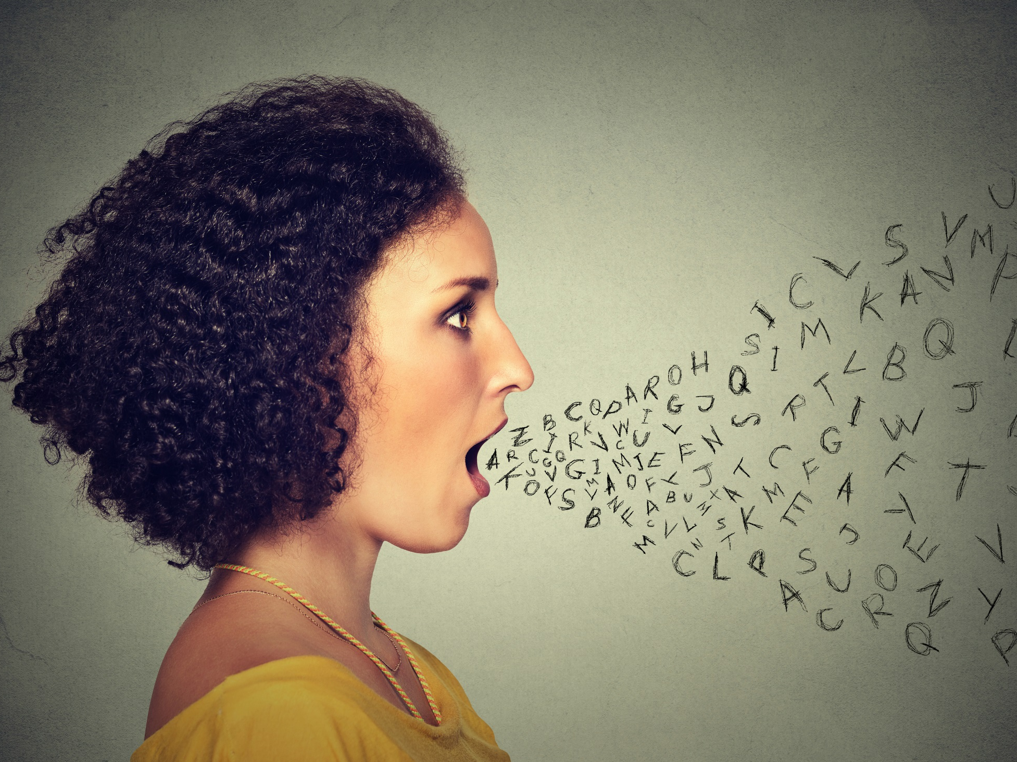
Jargon
Why do we use jargon?
…with colleagues?
…with the public?
Is using jargon categorically bad?
Notes:
***Conor (Bring markers)
Start at 3:12 (5 min)
It’s concise and efficient
The jargon word is often the most accurate word to use
Using jargon makes us feel like we are part of the club - it provides a sense of credibility to our audience.
HABIT!!!!!!
We forget that certain words are jargon.
We want to sound like we know what we are talking about.
Intimidate into belief.
Efficient- it is easier to summarize in less words

Slide 12
Types of Jargon
Technical Terms
Units and Equations
Multiple Meanings
Notes:
***Conor
Technical terms: self-explanatory, (e.g. title of you Ph.D. thesis)!
Units and Equations (this meshes with multiple meanings, e.g. mean (emotion) and mean (mathematical average)
Multiple Meanings

Slide 13
Technical Terms
Protein structure
DNA
Plasmid
Nanoparticle
Binder
Transformation
De novo
Mutation
Forward Folding
Rama scores
RIFDock
Symmetry Axis
SAXS
NCAA
“The Packer”
PAMPA
Notes:
***Conor
Blue: Jargon your familiar with (from MoLES website) Red: Jargon I’m familiar with (from my field: meteorology).
Given an example of how one could replace jargon:
Graupel or tiny balls of ice that fall from the sky but aren’t quite big enough to be called hail.
Cyclogenesis: the birth of a storm
Quasi-geostrophic theory: a theory that explains how a fast moving current of air (called the jet stream) affects our day to day weather.

Slide 14
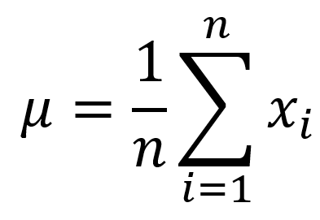
Units and Equations
Notes:
***Con

Slide 15
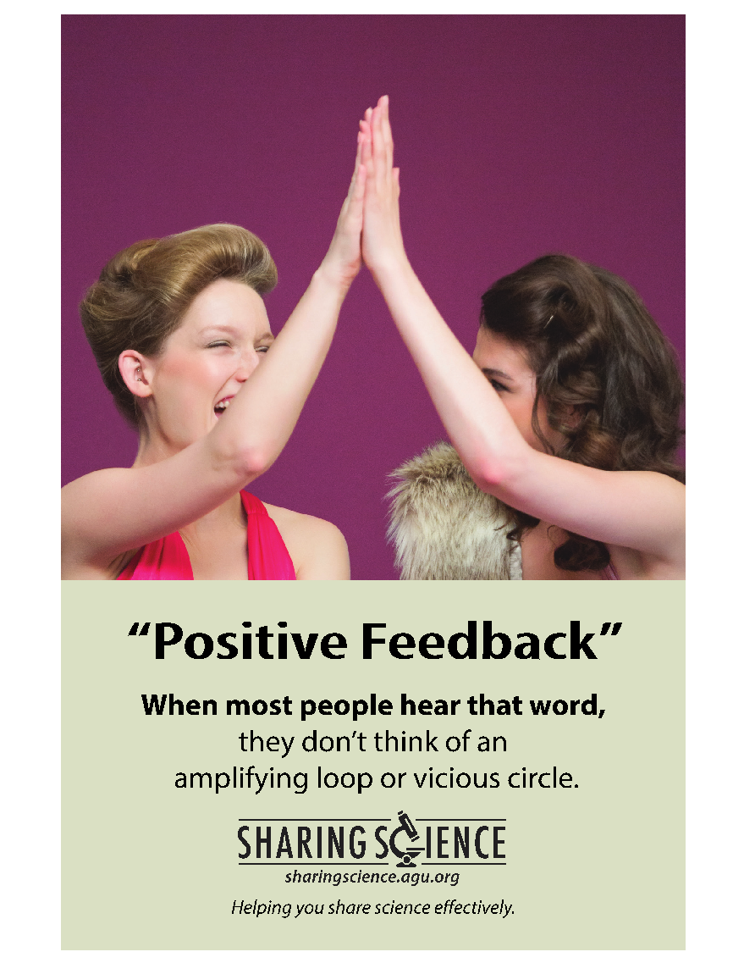
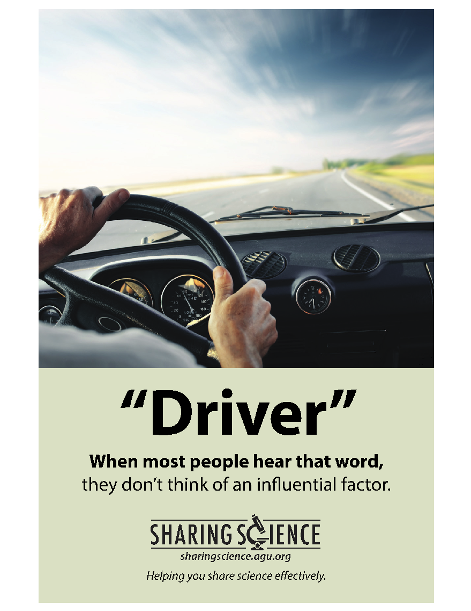
Multiple Meaning
Notes:
Positive Feedback, Mean, Driver (my dad probably thinks of another interpretation, his golf clubs), others: cycling, modeling, error, translation
Positive feedback: (careful- don’t define, just put in context of when talking to a general audience) audience might think a moment of being congratulated. Not know that could be good or bad feedback loop.
Even if these interpretations seem silly to you, they are still important to consider. It’s a bit of a double-edged sword: Never underestimate or overestimate the intelligence of your audience. They don’t need everything spelled out, but if they get hung up on a word that they know but that they know that their interpretation of the word is not what you mean in the current context, they will get hung up on that word and won’t follow what you say next because they’ll be stuck back here wondering what that piece of jargon really means.
It’s not just about not talking down to your audience, it’s about making sure that they are with you. Removing unnecessary obstacles to your goal, which is for them to understand your message, not to expand their vocabulary.

Slide 16
Why do scientists use jargon when talking to other scientists?
Notes:
Its concise and efficient, the jargon word if often the most accurate word to use, using jargon makes us feel like we are part of the club…

Slide 17
Why do scientists use jargon when talking to the public?
Notes:
HABIT!!!!!!
We forget that certain words are jargon.
We want to sound like we know what we are talking about.
Intimidate into belief.
Efficient- it is easier to summarize in less words

Slide 18
It’s okay to use jargon… …if you do it right.
Notes:
You can teach your audience science terms, and it makes them feel like part of the “in” crowd. Also, if you are using a word a lot, define it AT THE BEGINNING and be consistent! But, don’t overload your audience with new terms…just teach them the words that are absolutely necessary.

Slide 19
Say it another way.
Particles in the air instead of aerosol
Solar instead of photovoltaic
Plants instead of biomass
Or define it.
Nano
Polymer
Thermal
Conductive

Slide 20
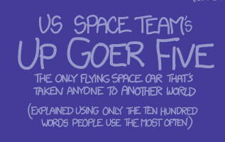
Tools to identify jargon
De-Jargonizer (scienceandpublic.com)
xkcd simple writer (1000 most common words)

Slide 21
Activity #2: Jargon
Individually: 3 minutes
Highlight the jargon you used in the written research description
Write down 3-5 jargon words from your research
At least one in each category on the board (technical terms, multiple meanings, units/equations)
As a class: 5 minutes
Discuss examples and/or ask for advice
Notes:
Goal start = 3:17; Goal end = 3:25 (8 min)
*******alternate activity: writing on whiteboard (under categories) all together, then discussing.
Needs: more expo markers!

Slide 22
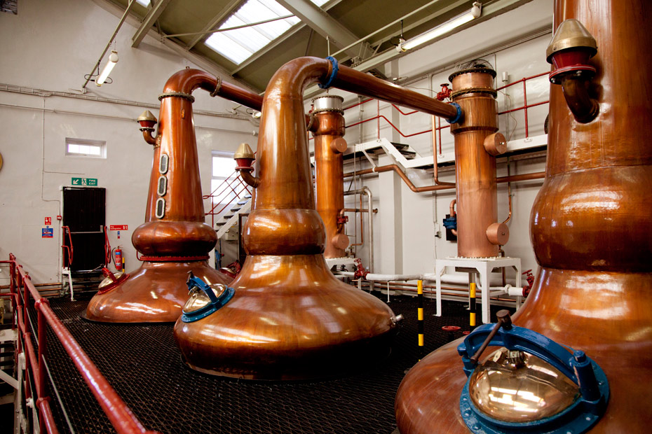
Distillation
Notes:
***Hally
Presentation: 3:25 Start, 3:30 end.
Activity: 3:30 start, 3:40 end.
5 minutes for slides, 10 min for activity

Slide 23
What is distillation?
Distillation is the process of extracting a liquid you want from a liquid mixture.
Distillation is extracting the most important components of something that is complex.
Notes:
What is distillation? Distillation is the process of extracting a liquid from a mixture of liquids. So, in liquor distillation → you want the alcohol, not the water.
For science communication, distillation is extracting the most important components of something that is complex. Give your audience the information they really need to understand the concept, and not extra fluff.

Slide 24
Distilling vs. Dumbing Down
Leaving out difficult content
“this content is too hard for you to understand”
Notes:
However, though on the surface they may seem quite similar, distillation is NOT dumbing down. Though the distinction can be nuanced, I find it really comes down to the attitude you have while talking to an audience. Dumbing down a concept is essentially saying to your audience that this content is too hard for you to understand and therefore I’m going to leave out the difficult content. This is a great to alienate your audience!
“Dumbing down” perhaps you won’t even try to explain it.

Slide 25
Distilling vs. Dumbing Down
Making concepts accessible to the public
Leaving out difficult content
“Distilling” ideas into relevant, digestible chunks
“this content is too hard for you to understand”
Notes:
Instead, make that difficult concept accessible to your audience and “distill” ideas into relevant, digestible chunks. This process is often helped along by the use of analogies!

Slide 26
Distillation & Knowing Your Audience
What information is absolutely necessary to communicate this concept to my audience?
Which details are important to my whole story? Which can be left out?
How complex is this topic? Can I present it with a few words?
Would an analogy benefit my audience?
Notes:
The other important aspect of distillation is knowing your audience so that you may properly distill the information.
How you distill information depends on the audience you’re presenting your research to. Are you talking to people in your field? Adjacent? The general public? Children? I think often we’ll consider the audience when we’re talking to people completely outside science, like your grandparents, but forget that you are the expert in your own research and thus, distillation applies at every level. This is especially true if you work in an interdisciplinary field.
For example, my research in oceanography straddles a few disciplines, particularly physical oceanography and biological oceanography. This past year, I’ve given two seminars, one to a group in biological oceanography and another to a group in physical oceanography. When I give a talk to the biology-minded, I have to spend a bit more time describing the mechanisms behind coastal upwelling but less time on the biology, while with the more physically-minded, I have to spend a bit more time describing the response in the phytoplankton, but less time on the physics.
Knowing your audience is also useful for crafting your analogies!

Slide 27
What makes analogies a powerful tool?
Analogies compare something unknown and complicated to something familiar and understandable.
“catalyst” =
….it doesn’t have to be perfect.
Notes:
A catalyst is like grease on gears because it makes the whole process run faster!
Or, from my example, coastal upwelling is like a conveyor belt because when the surface water is pushed offshore, deep water is brought up at the coast to replace that surface water.

Slide 28
Activity #3: Analogy Surprise
Form the same small groups.
Each group will get one object.
Create an analogy between the research of one person in your group and the object.
(10 min)
Notes:
Time: 3:30-3:40 (~10 min)
Think about all the characteristics/functions of your object.
Create an analogy between the research of one person in your group and the object.

Slide 29
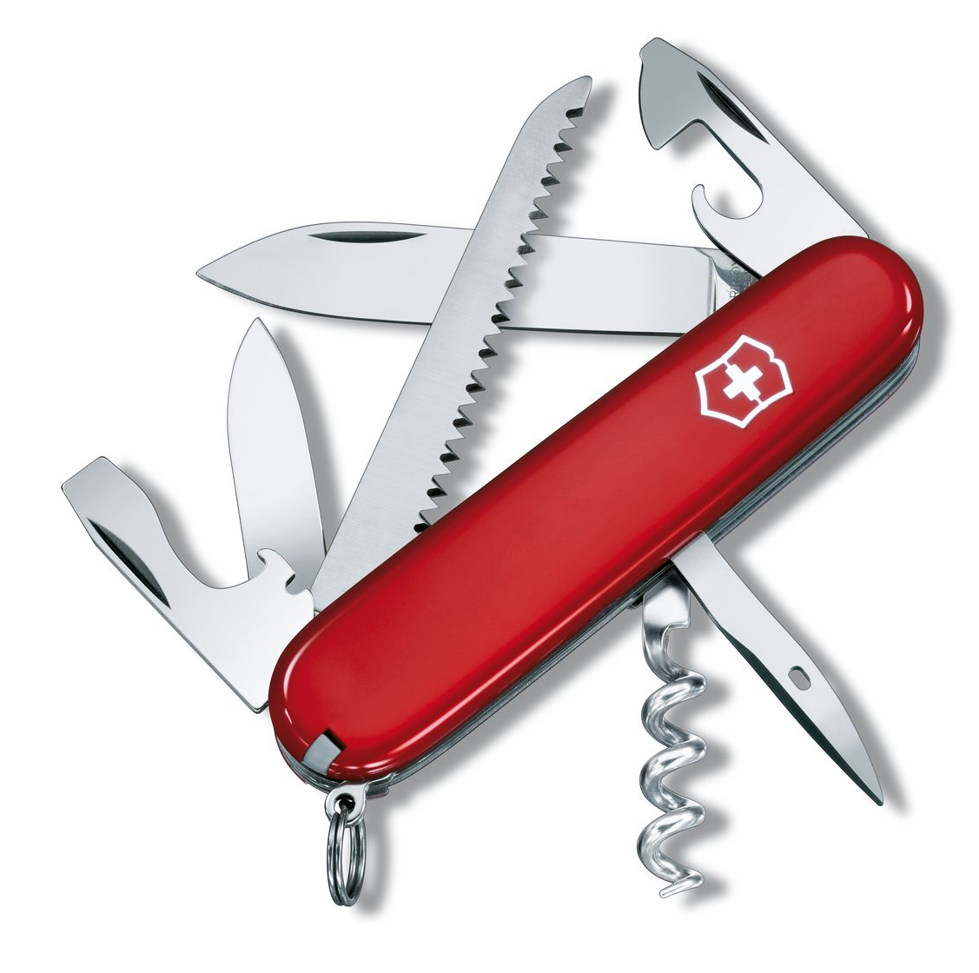
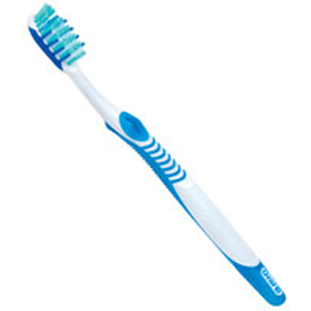
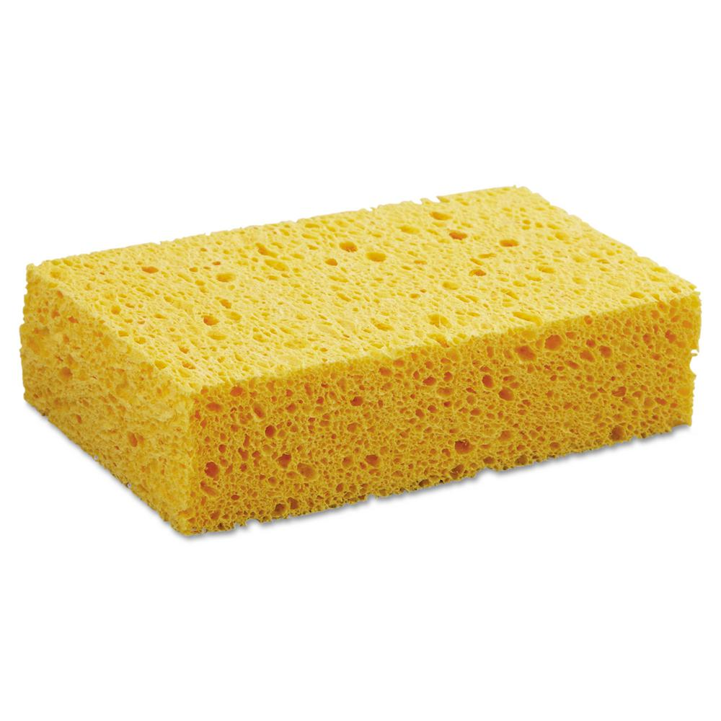
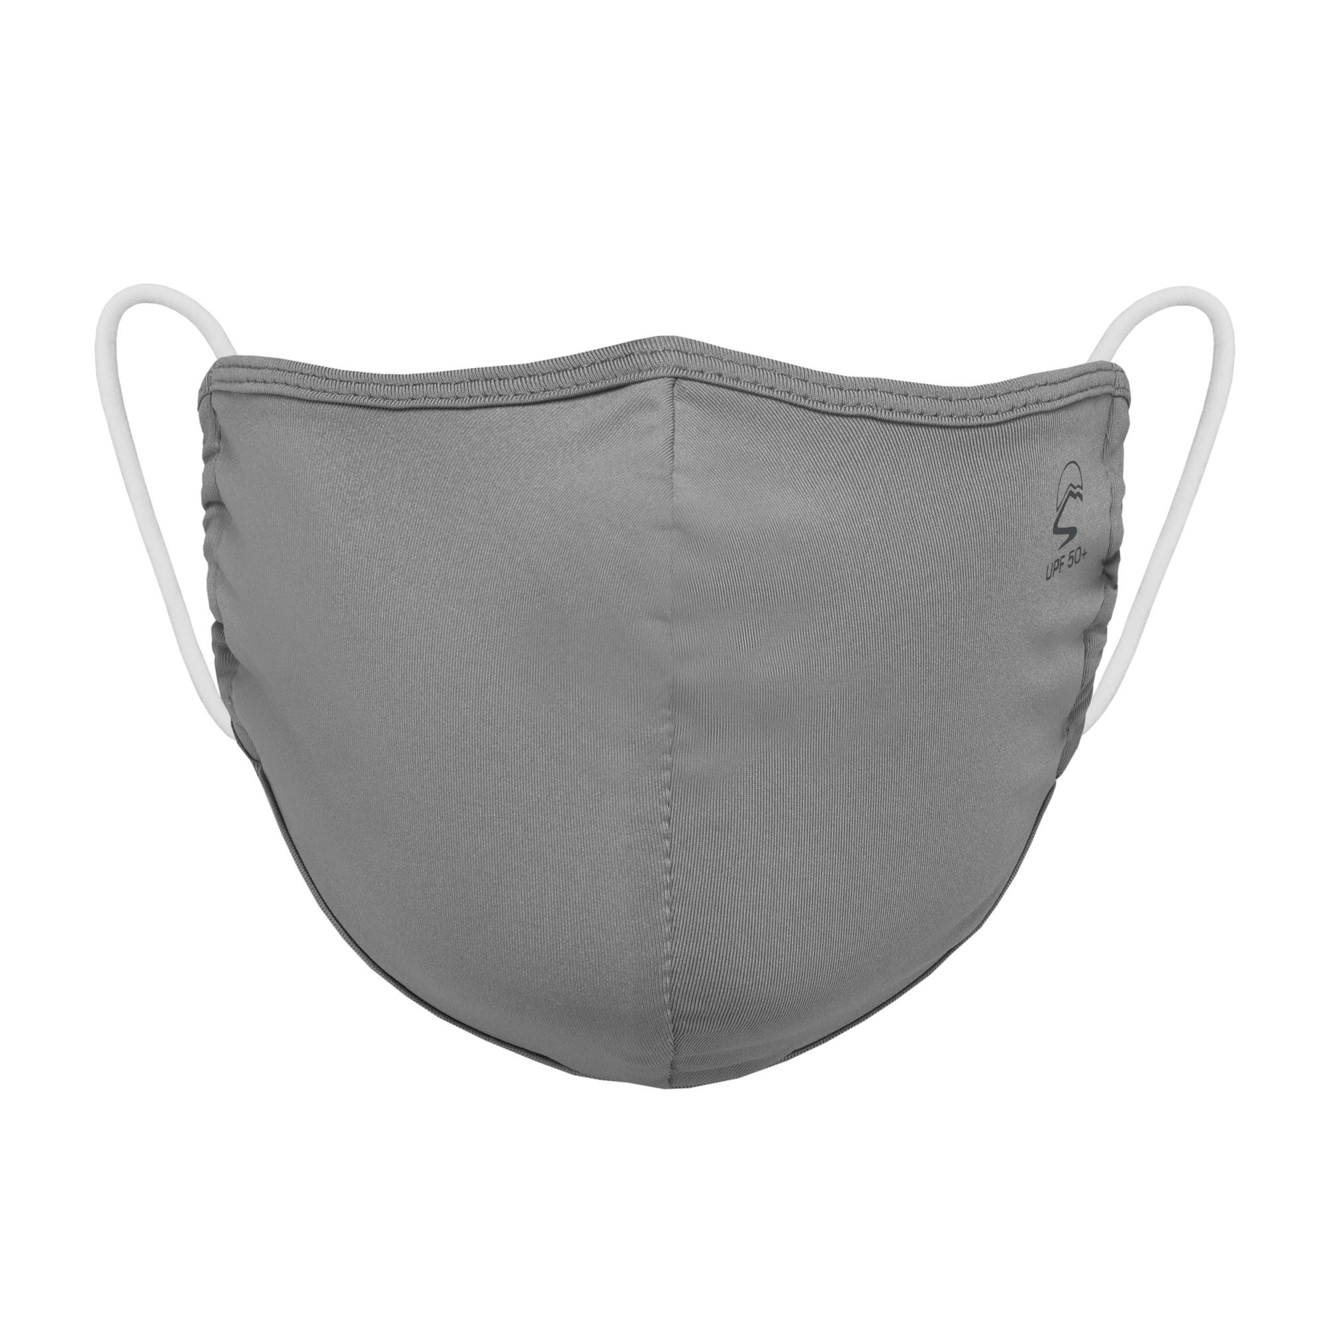
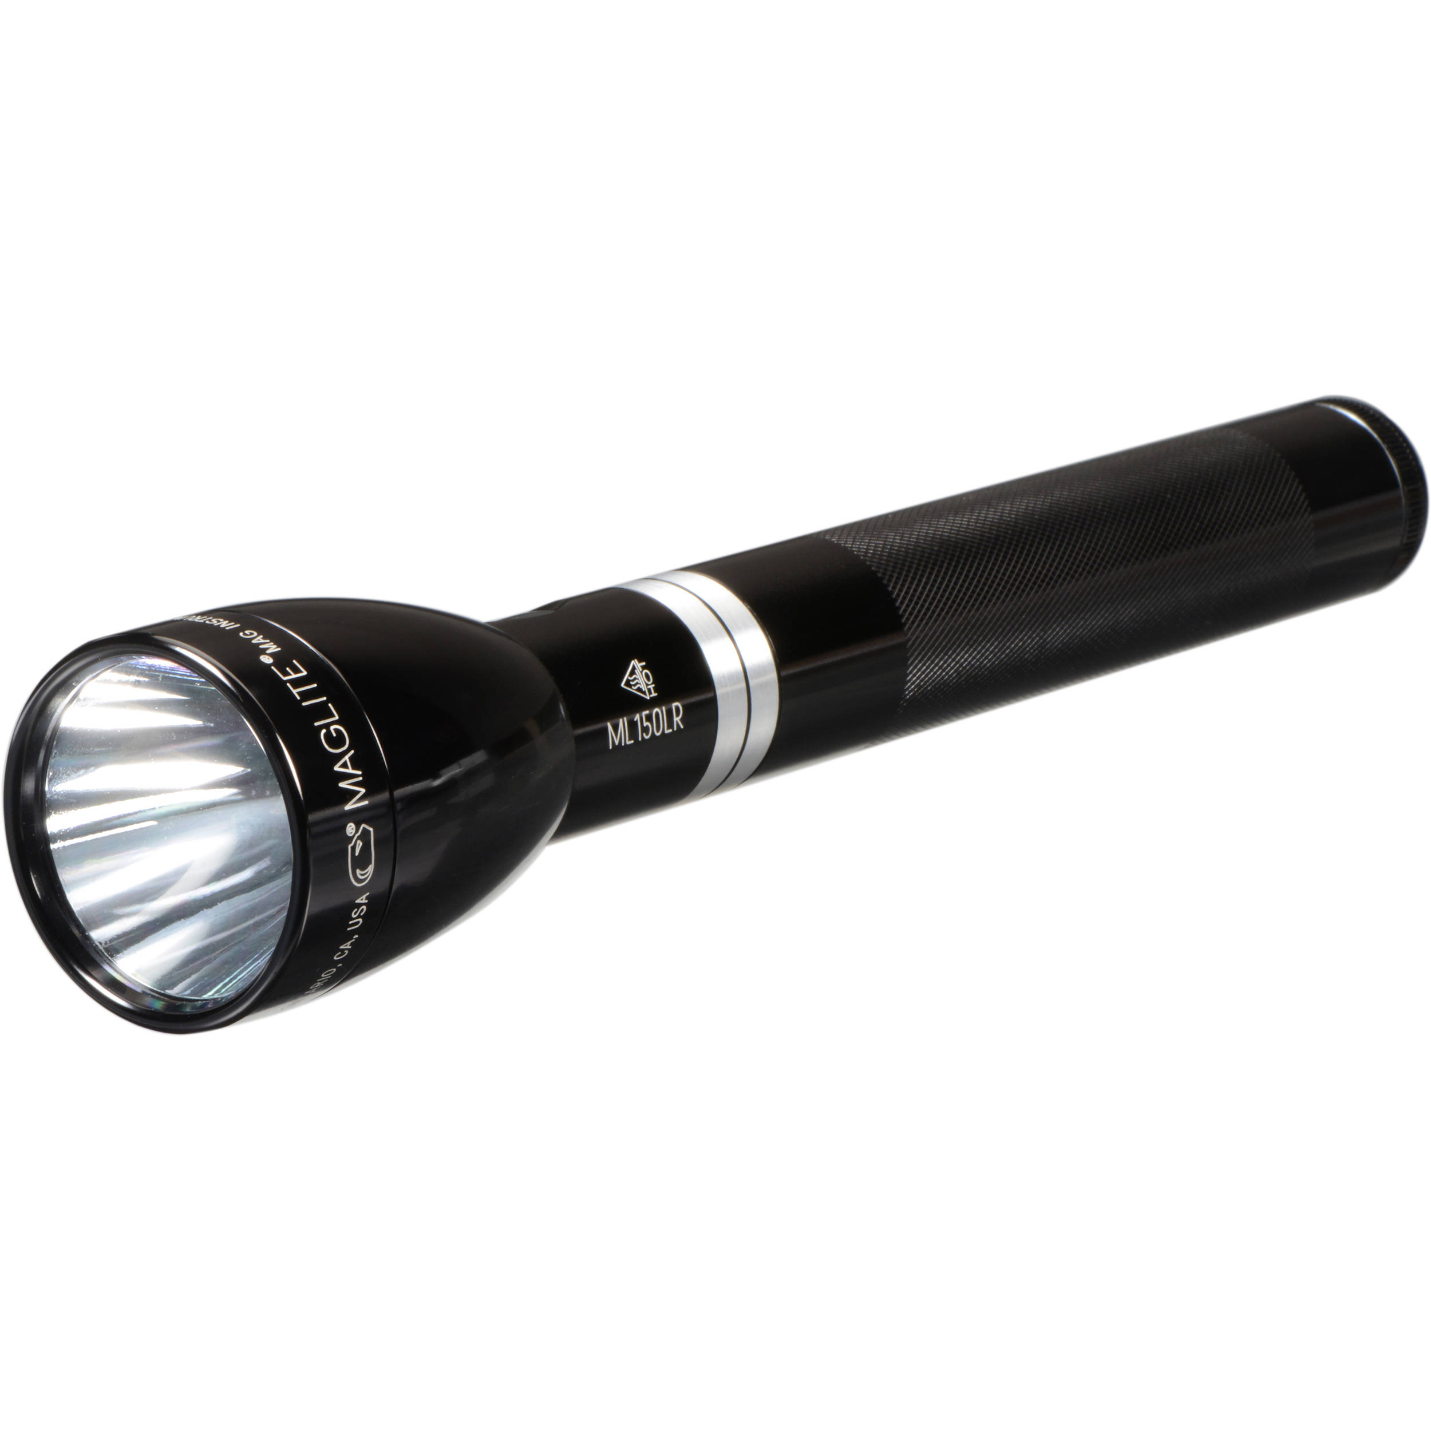
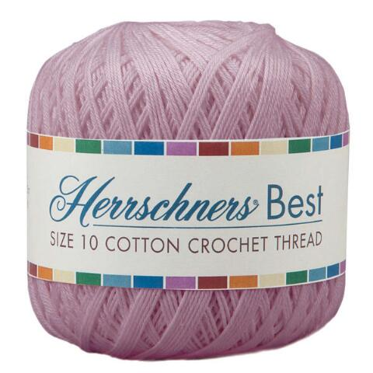
Notes:
2:20-2:25
Think about all the characteristics/functions of your object.
Create an analogy between the research of one person in your group and the object.
Offer type in Chat for participants uncomfortable with speaking out-loud.
Moderator adds analogy from their own research
If someone is stuck, allow others to provide an example
For those who are struggling, avoid choice paralysis by selecting one item specifically
Remind users of 5-min timeline.
Remind users of 1-min left.
Example from my own research and field of study:
Smartphone pressure sensors are varied in shape and size, like the bits on an allen wrench.
Like a sponge absorbing water, ozone molecules in the stratosphere absorb high-energy UV radiation from the sun.
Privacy models used to protect smartphone pressure data act like a mask in two ways. One: they protect your personal information by preventing it from being shared or spread, a lot like how masks prevent the spread of droplets that may transport COVID. Two: they help conceal your identity (hard to see your face when you wear a mask :D).
Roxanne and Body Language before pitches 2:25-2:30

Slide 30
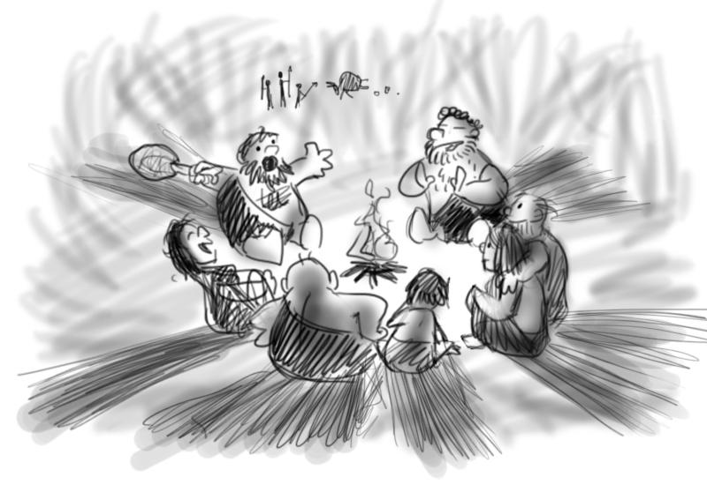
Storytelling
Ferdinand Englander, animatorisland.com
Notes:
***Mengying
Goal start = 3:40, end (narrative) = 4:00
Activity: 4:00 - 4:10 (10 min)
Mengying
Human are in a long history of storytelling. We are conditioned to receive information in the form of stories. Think about TV shows, news stories, commercials, personal statements. The most memorable ones almost always tell a story to keep the audience interested. So let’s take a minute to think about how we can use the format of story to help us improve our scientific presentation.

Slide 31
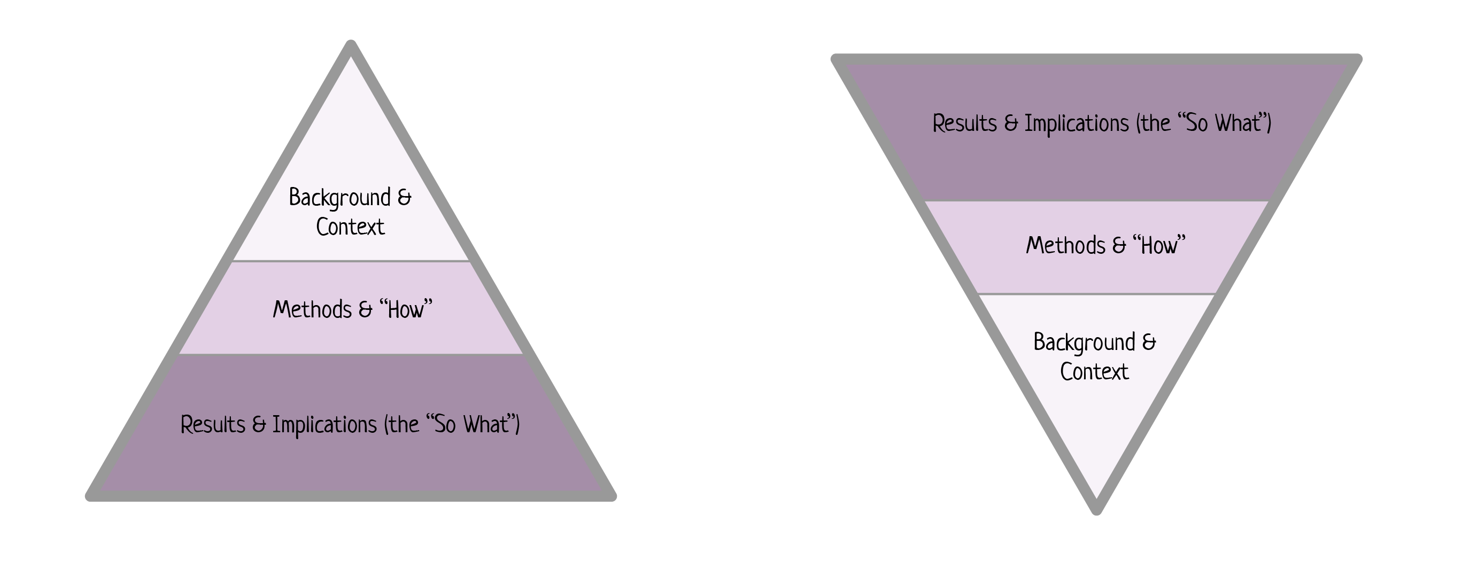

Slide 32
Typical Science Format
Introduction
Methods
Results
Conclusions
Notes:
Mengying
This is the format of a typical science presentation. Raise your hand if you’ve ever used this format. Who here has also fallen asleep during a scientific presentation with this format? ...and why is that?
What is missing in their presentation?
To answer that, we should ask first… Where is the tension?
Typical science format is dry, it maybe fine for a small group of people who know exactly what you work on. But for a broader audience, such as in a national conference or within a very interdisciplinary seminar, this format doesn’t work well. You want to keep the audience with you the all time, to have their minds to resonate with yours, to give them the take aways that they do remember afterwards. Here, the tension is important. Tension makes the audience engaged.

Slide 33
Where is the tension?
Notes:
Mengying
****identifying the best source of tension
That’s a hard question in scientific presentations, because usually there isn’t any. As a scientist, we are often trained to receive or tell information in a detailed, neutral tone, like writing a paper. It is nothing wrong, but can be very dry, and not memorable. And to keep our audience awake during a science talk we’d like to also build in some tension. Remember, good stories, always do an excellent job of including tension, so maybe we can learn to build tensions through building a story.
Luckily all of us already know the format of story even if we’ve never specifically thought about it.

Slide 34
Climax
Development
Tension
Complicating
Action
Resolution
Set-up/Hook
Act I
Act II
Act III
Time
Notes:
Mengying
***well-known story
So a typical story is often built with 5 stages. Set-up or hook is opening of the story, is the background, and introduce the main character. Complication action introduce the main focus, the main problem. Development is usually the longest parts, describe the actions the character take and the results he or she got, even though might be mixed results. Climax is where the tension reaches its peak. Resolution is the end of the story.
Set-up: Harry is an unwanted kid and lives in a family treated him bad. (protagonist, situation)
Complicating Action: He is told he is a wizard and is going to learn magic. (main problem)
Development: Harry is struggled to pass his classes and succeeded in Hogwarts. He also struggles because he realizes there might be something bad happening in Hogwarts. (protagonist struggles to meet goals)
Climax: Harry and his friend take action to stop Quirrell from stealing the philosopher’s stone and stop Voldemort from back to life . (take home message)
Resolution: House Gryffindor is rewarded the house cup. (epilogue)
Also think about starting broad, getting narrow, the broadening it up at the end.
Notes:
Set-up: This is the opening of the story, the background. This is setting the scene for the story, introducing the protagonist, and explaining the current state of things before the tension starts.
Complicating Action: This is the first obstacle the protagonist hits. Often, this is the main question you’re trying to solve, or the problem.
Development: The protagonist tries various things to solve the problem, with mixed results. Sometimes, they succeed, and sometimes they fail, but the story keeps moving forward. This is generally the longest part of the story.
Climax: This is where tension reaches its peak. In your talk, this should be the take-home message, the most important thing you want the audience to come away with.
Resolution: The epilogue of the story. Now that the protagonist has been through all that, what have they learned. Where are they now? What will they do next?

Slide 35
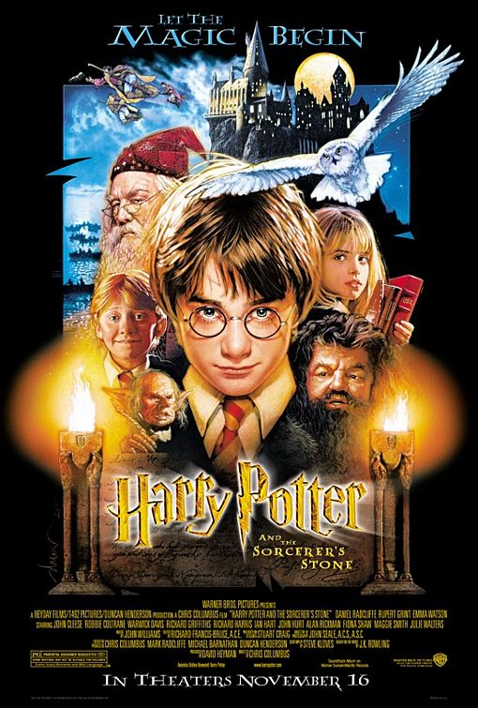
Notes:
Mengying

Slide 36
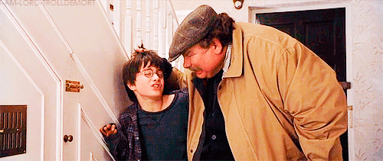
Tension
Set-up/Hook
Act I
Act II
Act III
Time
Notes:
Mengying
***
Set-up: This is the opening of the story, the background. This is setting the scene for the story, introducing the protagonist, and explaining the current state of things before the tension starts.
Set-up: Harry is an unwanted kid and lives in a family treated him bad. (protagonist, situation)

Slide 37
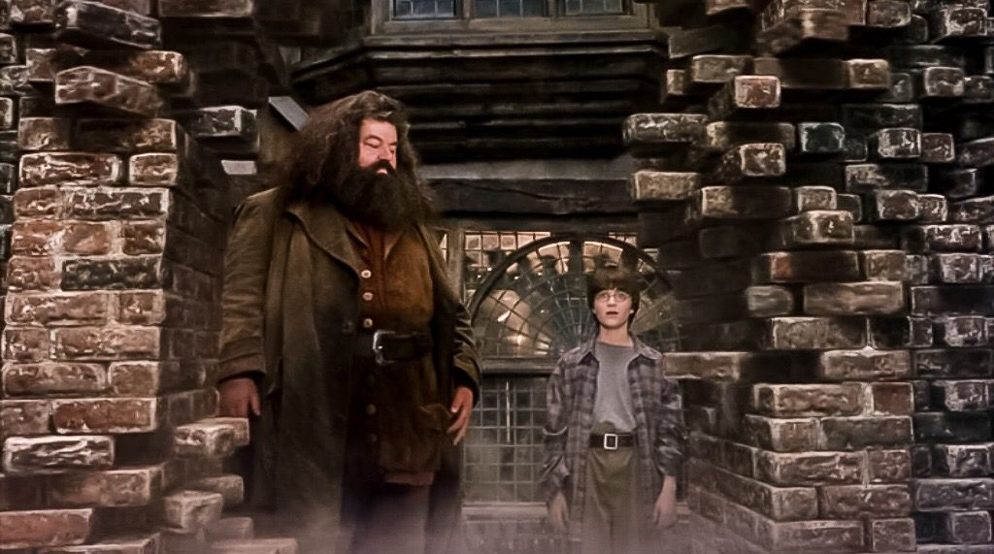
Tension
Complicating
Action
Act I
Act II
Act III
Time
Notes:
Mengying
***
Complicating Action: This is the first obstacle the protagonist hits. Often, this is the main question you’re trying to solve, or the problem.
Complicating Action: He is told he is a wizard and is going to learn magic. (main problem)

Slide 38
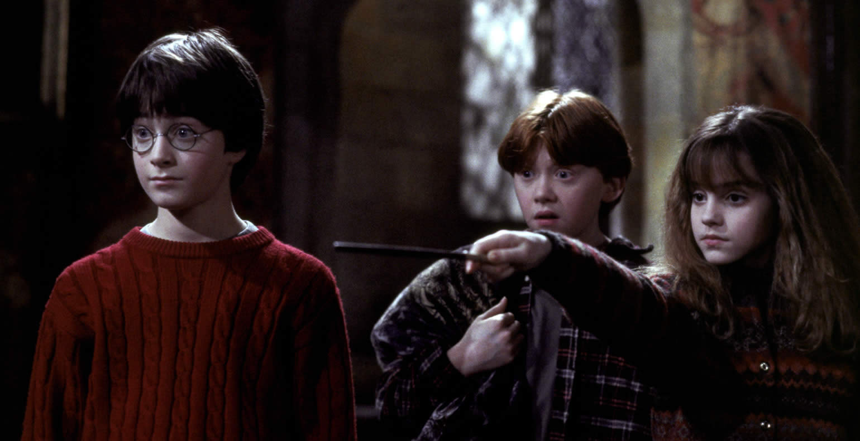
Development
Tension
Act I
Act II
Act III
Time
Notes:
Mengying
***
Development: The protagonist tries various things to solve the problem, with mixed results. Sometimes, they succeed, and sometimes they fail, but the story keeps moving forward. This is generally the longest part of the story.
Development: Harry is struggled to pass his classes and succeeded in Hogwarts. He also struggles because he realizes there might be something bad happening in Hogwarts. (protagonist struggles to meet goals)

Slide 39
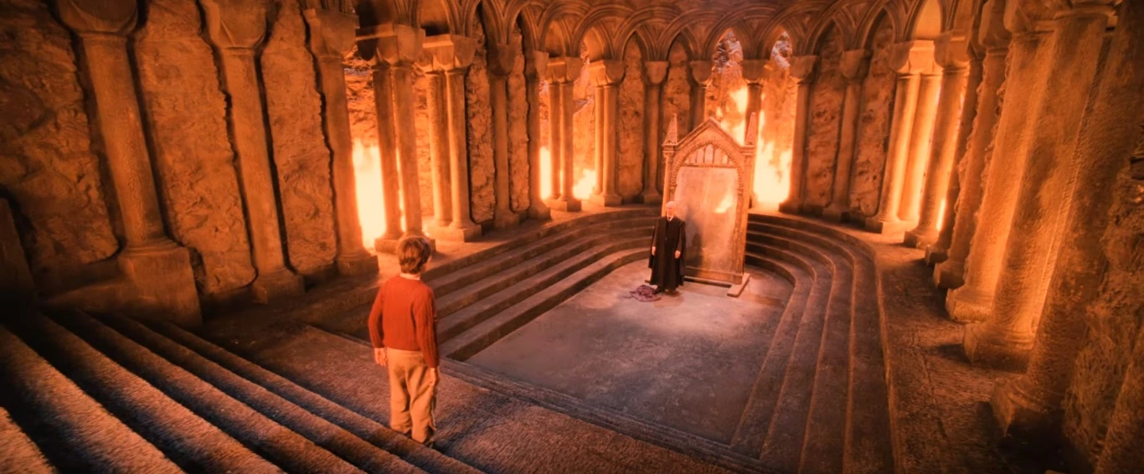
Climax
Tension
Act I
Act II
Act III
Time
Notes:
Mengying
***
Climax: This is where tension reaches its peak. In a story, it’s often the most exciting part. In your talk, this should be the take-home message, the most important thing you want the audience to come away with.
Climax: Harry and his friend take action to stop Quirrell from stealing the philosopher’s stone and stop Voldemort from back to life . (take home message)

Slide 40
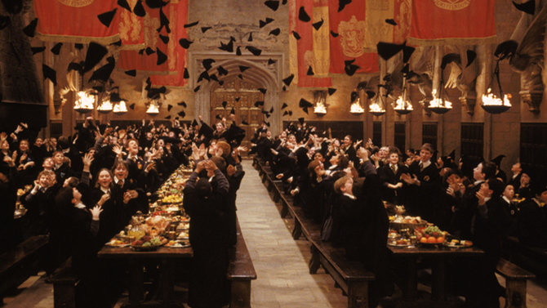
Tension
Resolution
Act I
Act II
Act III
Time
Notes:
Mengying
***well-known story
Resolution: House Gryffindor is rewarded the house cup. (epilogue)
Resolution: The epilogue of the story. Now that the protagonist has been through all that, what have they learned. Where are they now? What will they do next?

Slide 41
Science Format
Story Format
Introduction
Methods
Results
Conclusions
Set-up
Complicating Action
Development
Climax
Resolution
Notes:
Mengying
Notice no methods! **Or at least little method.
Well that makes sense. When you have limited time (like 12-20 min in a conference), you want to get your audience engaged into your research as soon as possible. Details is needed for paper and repeat an experiment, but not for a talk.
Other scientists in our fields are more interested in the conclusion, the main takeaway. To get there, they want to listen why your research is important (intro), and want to know how that led to the conclusion (result).
How you got there (results, not methods)
Importance (intro)

Slide 42
Science is storytelling!
Notes:
Mengying
****You might think: oh the story format might work better for TV show or novel. My research is so dry how could it apply to me. Well, science itself is storytelling! Science is full of conflict, contradiction, research, resolution. There is enough tension to build a narrative, there is always amazing thing in the process people feel interested. Science is not just full of plain data or graphs. How to select data and present the key story is important.

Slide 43
Climax
Development
Tension
Complicating
Action
Resolution
Set-up/Hook
Act I
Act II
Act III
Time
Notes:
Mengying (Fill in with pictures, or divide it into different slides)
*Maybe give an example of my storyboard
****Science version of the story.

Slide 44
Title: Designing a binder to a targe
Set-up/Hook
Complicating Action
Development
Who here’s taken a prescription drug? They’re great right?
...But they always have side effects.
That’s because they often bind to the wrong target.
Climax
Resolution
We found we could use Rosetta to design binders
Now we can use Rosetta to try to make new medicines!
Notes:
Mention I’ll expand the words into multiple slides or have images
Expand each box into multiple slides with each slide focusing on one stage with multiple images.
Highlight the emotion.

Slide 45
Another element of every story: a protagonist
Notes:
Grace
Goal start (protagonist) = 1:53, end = 2:00 (7 min)
Every story must have a hero. Someone to root for, like Harry Potter. But how do find the protagonist to your science story?

Slide 46
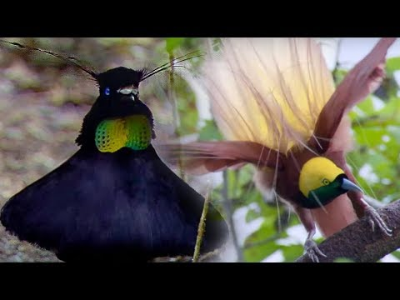
Identifying your protagonist
Notes:
Grace
*Start video at 2:05*
Don’t you just feel for that lovelorn bird of paradise? How can you not? But what if your research subject is not so charismatic?

Slide 47

You are a compelling protagonist
https://www.potterybarn.com/products/mendosa-arch-wood-mirror/?catalogId=84&sku=3351454&cm_ven=PLA&cm_cat=Google&cm_pla=Pillows%20%26%20Decor%20%3E%20Wall%20Mirrors&cm_ite=3351454&gclid=EAIaIQobChMInPz-l6665AIVRhitBh1s2grPEAQYAyABEgKWMvD_BwE
Notes:
Grace
But the easiest place to find a protagonist is IN THE MIRROR. You––yes, you–– are a more compelling protagonist than any lovelorn bird or photovoltaic cell. The scientific process is an uphill battle filled with emotional changes. And you are the one doing battle. You feel things about your science ( if you’re anything like me, usually frustration). As scientists we are trained to remove ourselves from our science, to speak in the passive voice and pretend that we have no emotional stakes in the outcomes of our experiments. But as a storyteller you are free to do the opposite. Your struggles and successes constitute stakes that an audience will care about.
crediblity, engage with audience
Talk about the experience of me figuring out

Slide 48
Develop an Elevator Pitch!
Split into pairs
Explain your project to the other person, adapting the sentences you wrote earlier. The other person will time you and cut you off at 2 minutes.
Give each other feedback. Take the time to think about what your core message is.
Now repeat the activity- but you only have 1 minute
Now repeat – you only have 30 seconds
Now repeat- you only have 15 seconds
Notes:
Start: 4:50
Remember: applications coming out at the end of October!
5-10 minutes for evals and questions

Slide 49
Homework: Storyboard!
15 min to write the storyboard for a ~15 min presentation. (can be 1-2 sentences in each box!)
Create slides for your presentation and then practice it twice- once with someone in this group, once with a friend not working in this lab
Avoid jargon
Use story format
Distill information (could an analogy help?)
Remember to think of your audience!
Notes:
Start at 4:10
15 min to write (4:10 - 4:25) **can shorten to 10 min if necessary
25 min to pitch in groups (4:25 - 4:50), 3 leads so groups of 6
(Rachel does this slide)
Change the elevator pitch feedback form to be more workshop relevant.

